Slide 1
DYNAMIC WEATHER DASHBOARD
CAPSTONE PROJECT
Presented By:
MODEKURTI SRIHARSHA – ANURAG UNIVERSITY – COMPUTER SCIENCE AND ENGINEERING

Slide 2
OUTLINE
Problem Statement (Should not include solution)
System Development Approach (Technology Used)
Algorithm & Deployment (Step by Step Procedure)
Result
Conclusion
Future Scope
References

Slide 3
Problem Statement
Users need real-time, location-based weather information in a simple interface.
This dashboard fetches and displays weather data like temperature, conditions, and forecasts.
It enhances user convenience and travel planning.

Slide 4
System Approach
Frontend Technologies:
HTML5 – Structure of the webpage
CSS3 – Styling and responsive layouts
JavaScript – Dynamic interactivity (Fetching real-time weather data from the XWeather API, Dynamically updating the page )
Design Approach:
Clean and User-Friendly Interface
Employs a clean, card-based design to present weather metrics in a scannable format.
Prioritizes key information at the top with a clear visual hierarchy for easy reading.
Mobile-Responsive Design
Utilizes responsive design principles to ensure the layout adapts to different screen sizes.
Provides a consistent and usable experience on both desktop and mobile devices.
Modular Separation of Files
Separates concerns by using distinct files for structure (HTML), presentation (CSS), and logic (JavaScript).
Enhances maintainability by breaking down JavaScript into smaller, feature-specific files.

Slide 5
Algorithm & Deployment
Product Catalog Creation
Defines weather data points (temperature, icons, descriptions) fetched dynamically from the XWeather API.
Frontend Design
Lays out weather data using a card-based grid system structured with HTML and styled with CSS.
Interactive Features
Dynamic weather alerts
Extended and specialized forecasts
Search autocomplete
Live data maps
Basic internationalization
Testing
Ensures mobile responsiveness and cross-browser functionality through manual testing and user feedback.
Deployment
Hosted on GitHub Pages for free, continuous, and easy public access.

Slide 6
Result
Github link
https://msh-gh.github.io/DYNAMIC_WEATHER_DASHBOARD_IBM_EDUNET_FRONTEND_INTERNSHIP/

Slide 7
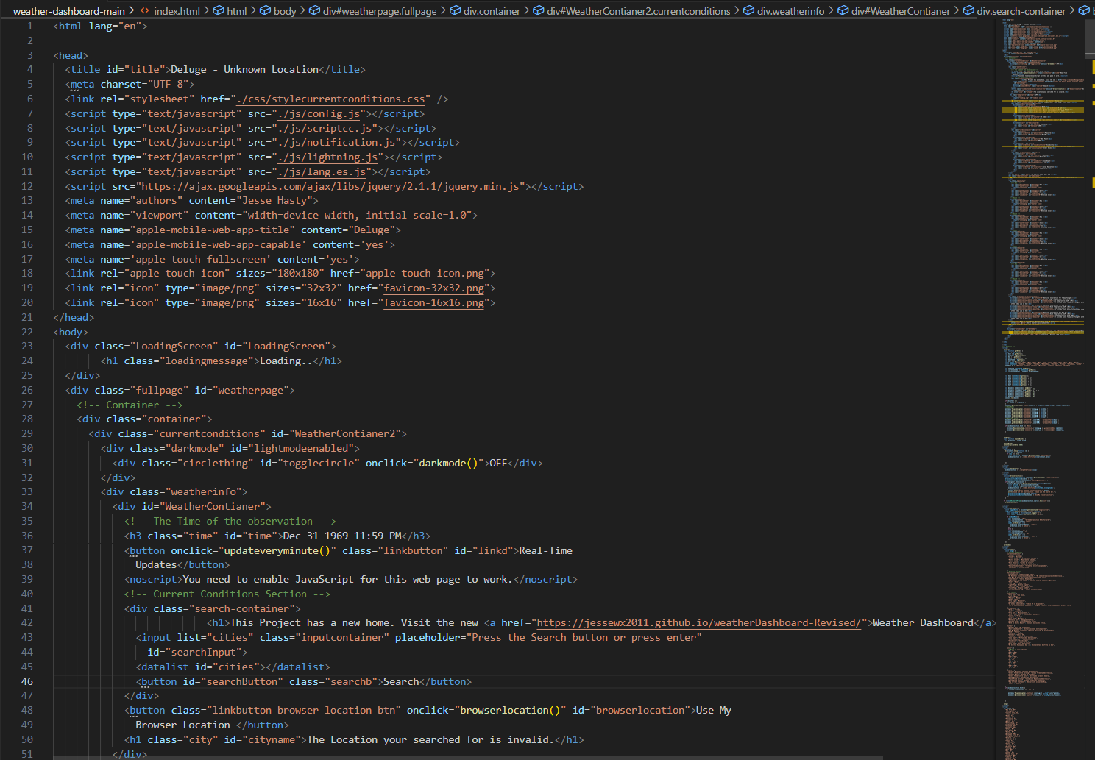

Slide 8
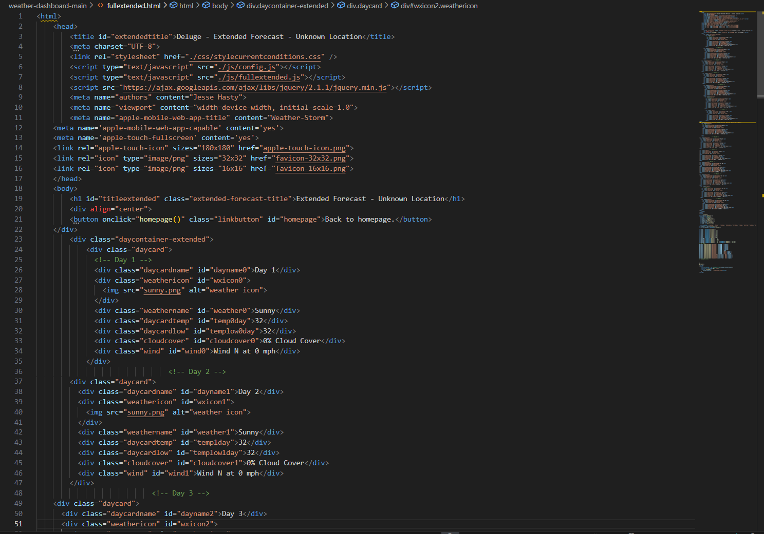

Slide 9
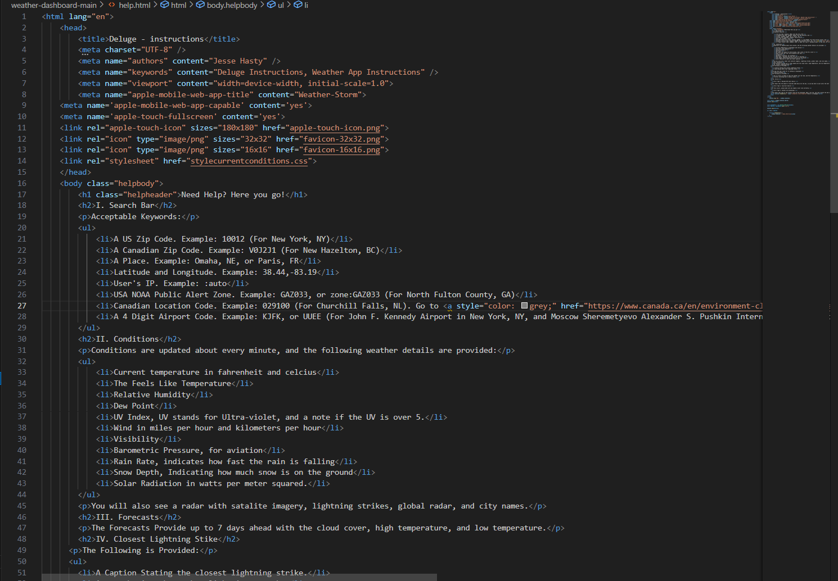

Slide 10
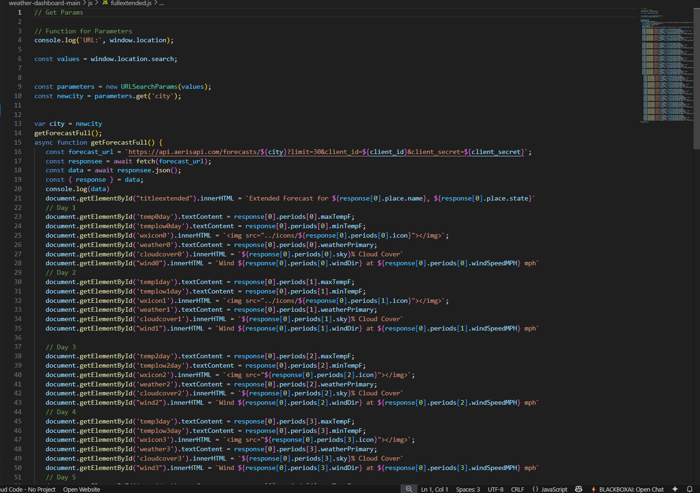

Slide 11
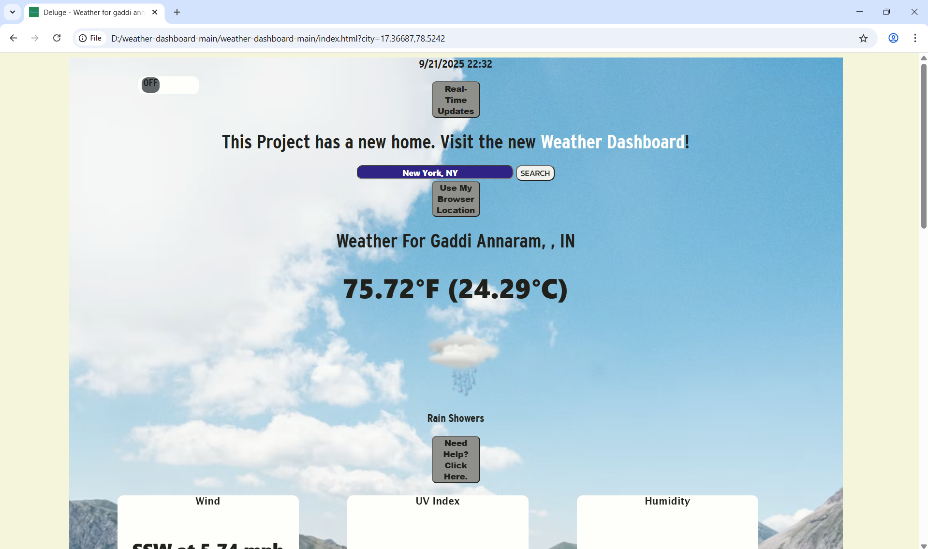
Output screenshot - 1

Slide 12
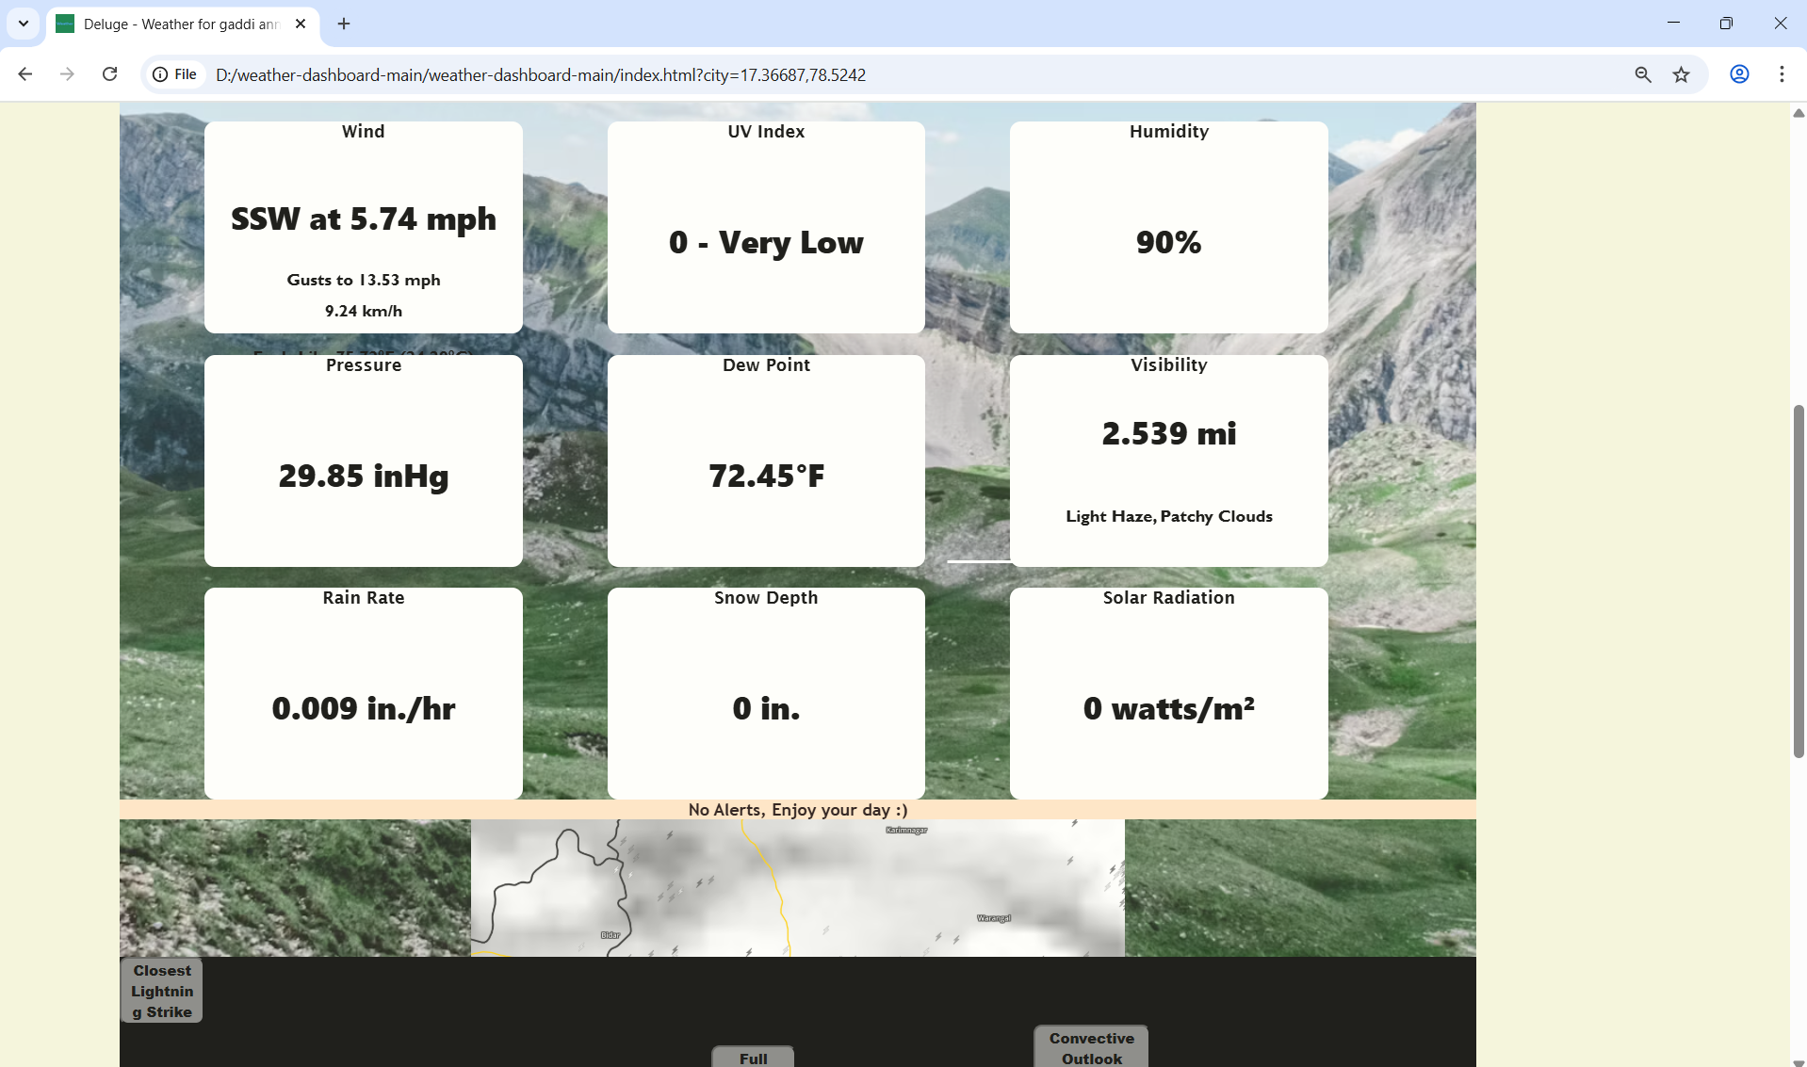
Output screenshot - 2

Slide 13
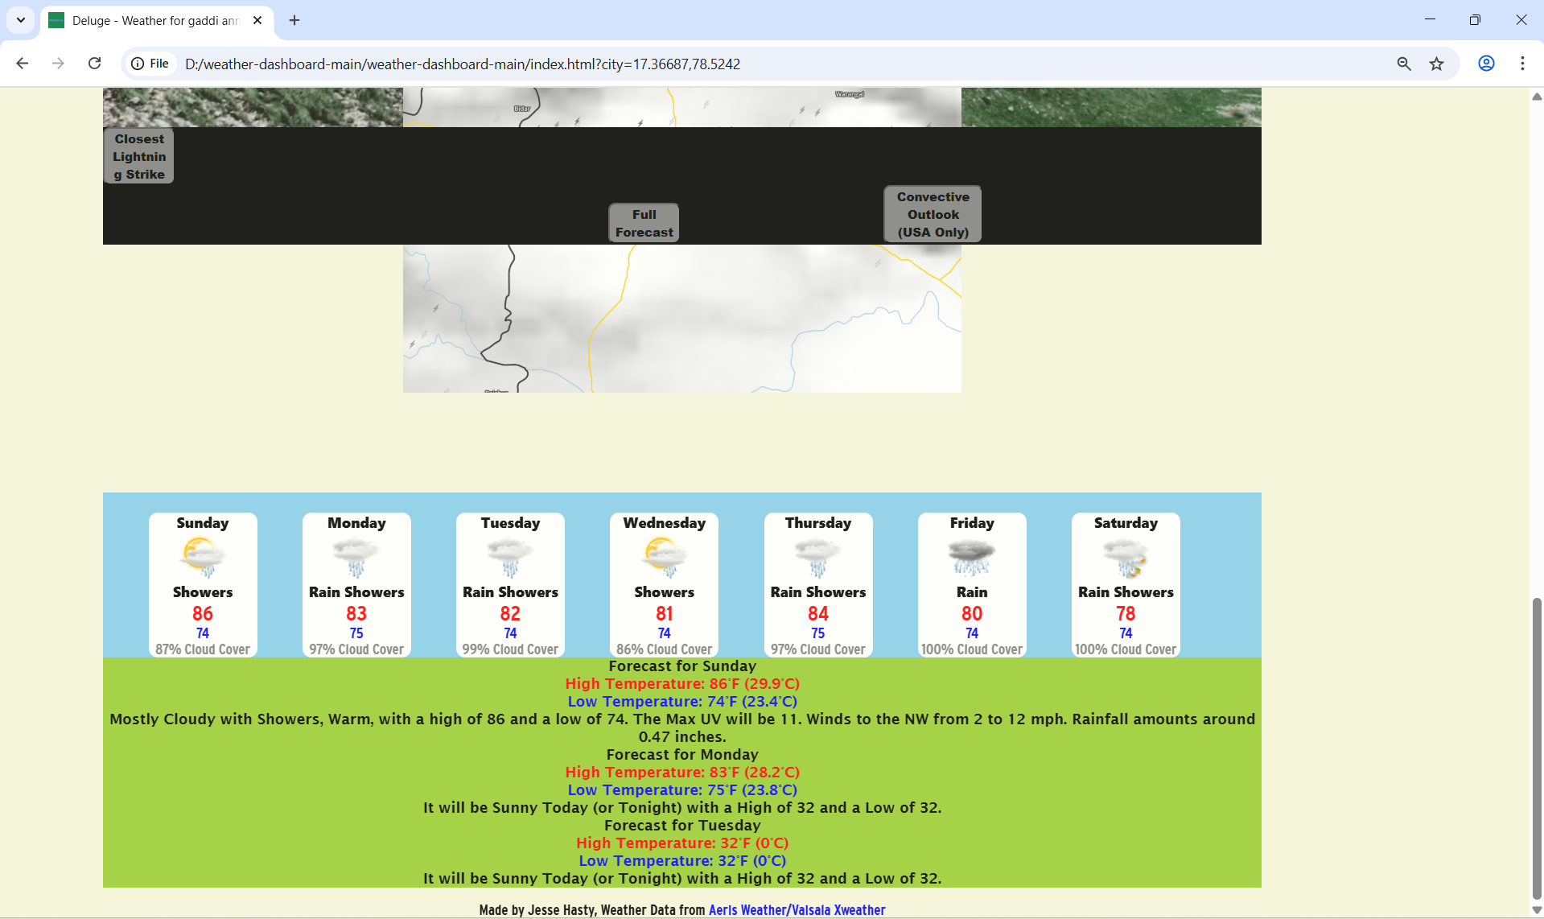
Output screenshot - 3

Slide 14
Conclusion
Provides a powerful, cost-effective weather solution. Built using standard web technologies and hosted for free on GitHub Pages, it offers a feature-rich experience without expensive platform fees.
Eliminates dependency on generic, third-party widgets. As a custom-built application, it provides complete control over the user interface and feature set, avoiding the limitations of pre-packaged solutions.
Offers an engaging and interactive user experience. Features like live search, geolocation, dynamic radar maps, and detailed, clickable forecasts create a rich and responsive user-centric dashboard.

Slide 15
Future scope
Backend Integration: Develop a Node.js backend to manage user accounts, save favorite locations, and secure API keys.
Premium Features: Integrate a subscription model for premium features like historical data or high-resolution maps.
Admin Dashboard: Create an admin dashboard to manage application data (like city lists) and monitor API service health.
AI-Powered Insights: Implement AI-driven analytics to provide personalized weather summaries and predictive severe storm insights.

Slide 16
References
https://www.xweather.com/docs/
https://developer.mozilla.org/en-US/docs/Web/API/Geolocation_API
https://developer.mozilla.org/en-US/docs/Web/API/URLSearchParams

Slide 17
THANK YOU

